Slide 1

Manchester City Evolution 2000 - 2021

Slide 2
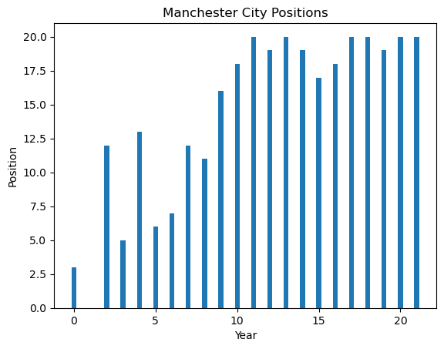
League Position
Means Position = 1
2008

Slide 3
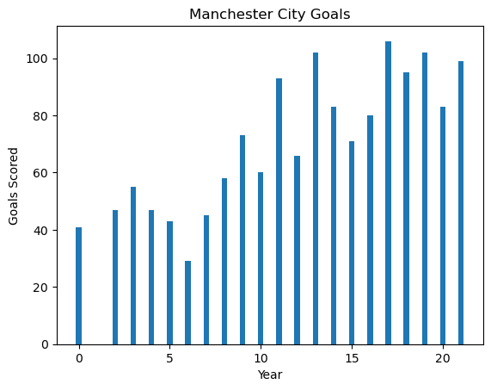
Goals Scored
Also in 2008

Slide 4
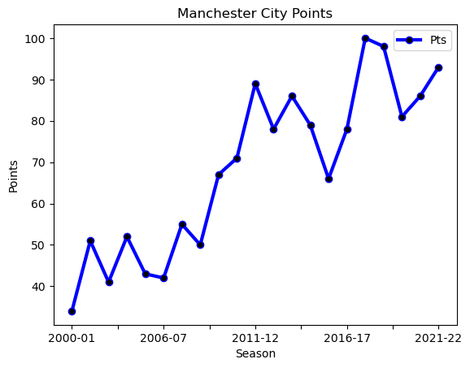
Points
2008 the magical year

Slide 5
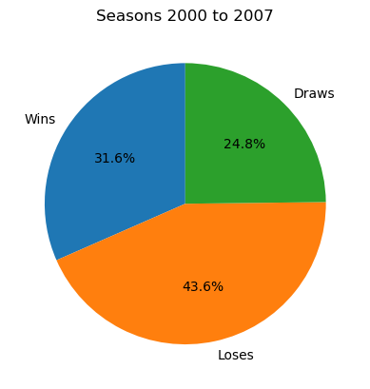
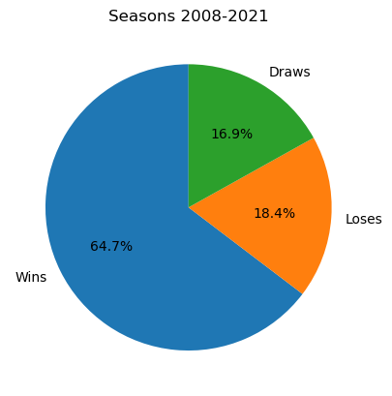
Can you see how does their wins increased
Wins, Loses, and Draws

Slide 6


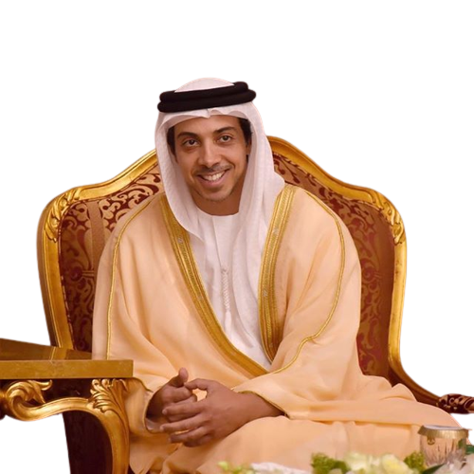
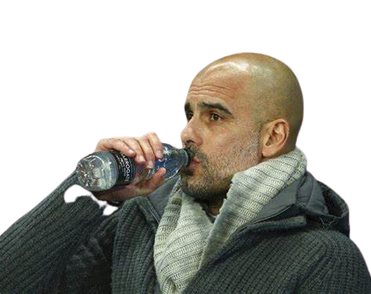

But what happened in 2008 ??
Sheikh Mansour bin Zayed so no need for any explanations
Then in 2016, Pep became the coach

Slide 7
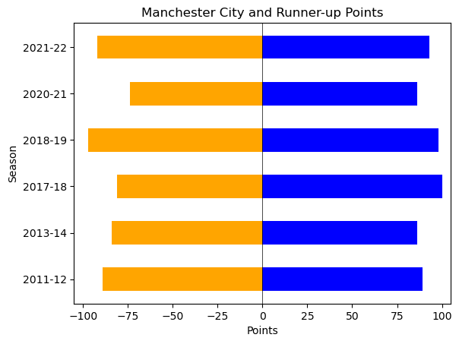
One can say that the league then wasn’t good, or the clubs weren’t good, see this graph first
which illustrates the points scored by Manchester City in a winning season and its runner-up
Competitiveness
And if you can’t see the very small margin of points between Manchester City
and its competitive in a specific season, have a look on the next slide

Slide 8
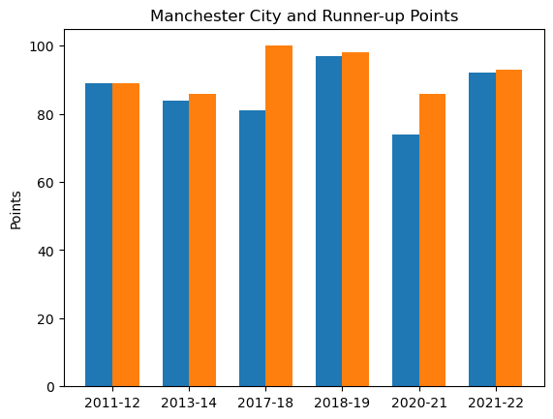
Competitiveness
Very close right,
well not in all seasons

Slide 9
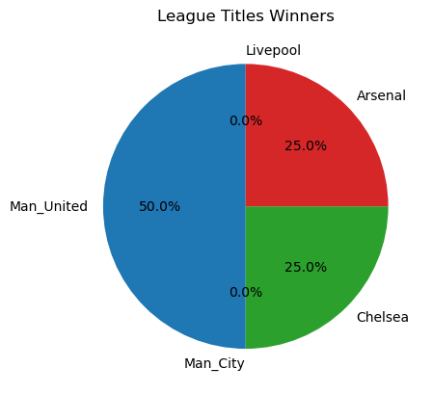
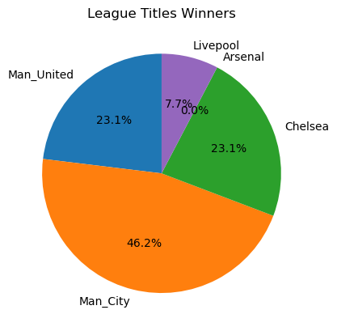
Now let’s look at the League titles before 2008 and after
Before
After
0 Leagues
6 Leagues
League Titles

Slide 10
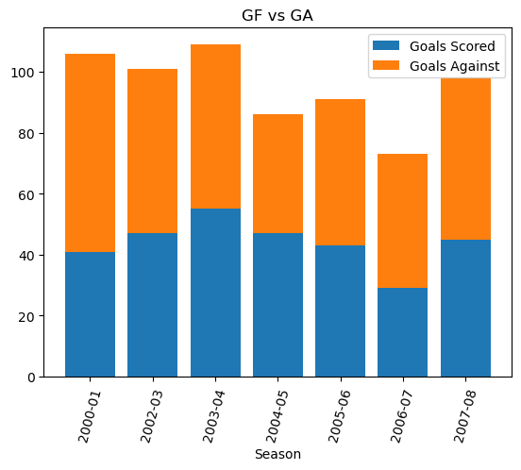
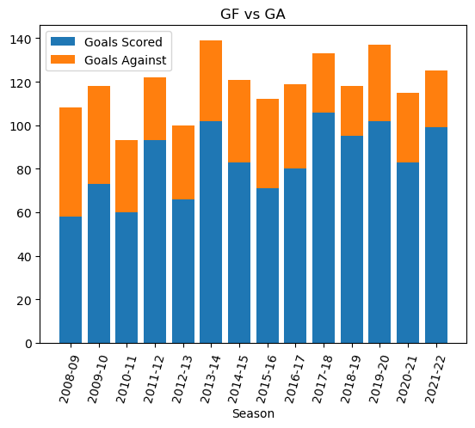
Pre 2008
Post 2008
Goals Scored vs Goals Against

Slide 11
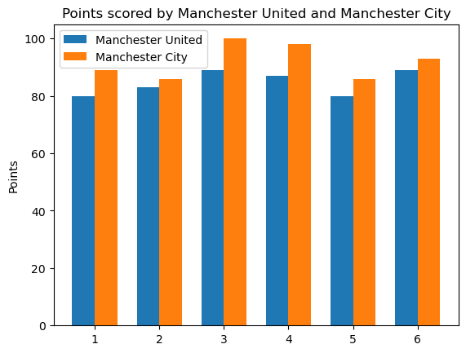
Let’s now compare Manchester City’s numbers,
and one of the best clubs in England numbers
Manchester City Vs Manchester United
(Points Scored by each in their winning seasons)
Manchester City wins

Slide 12
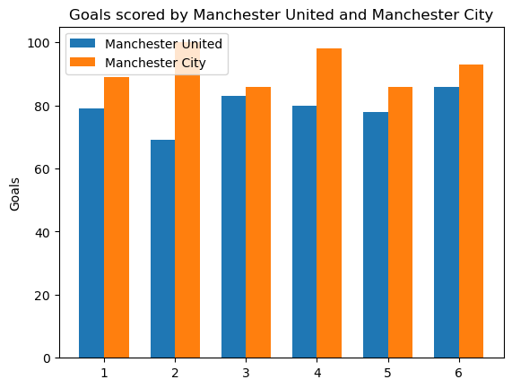
Manchester City Vs Manchester United
(Goals Scored)
No doubt

Slide 13
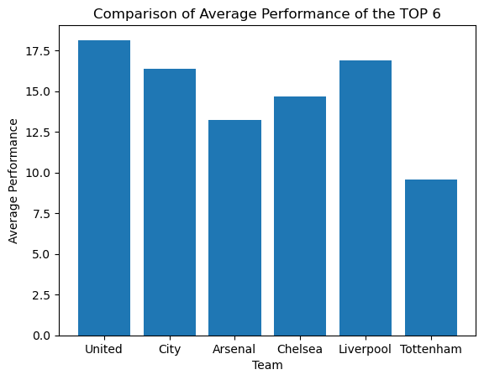
Now let’s see the overall average Performance
of the Top 6
Average Overall Performance
There is no doubt that Manchester City is becoming
one of the best clubs in England, it’s just a matter of
time to be the best

Slide 14
Thank you

